Slide 1


E- Learning
Done by:
Anjan Pradhan
Kamesh V R
Silvan
Subiksha S

Slide 2
Introduction
E- Learning application is used by students worldwide, it will be a platform to connect students and teacher around the world. This application mainly focus on providing different courses to the students and teacher will be managing and monitoring the students' academic activities .
Future Development Plans
Providing Assignment Service
Conducting Test for different Courses and Providing Certificates

Slide 3

Cont..,
This application is done with Spring Boot and Angular which will be the basic important technologies to create a web applications.

Slide 4
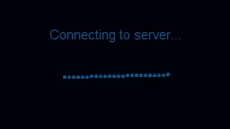
CONCEPTS AND TECHNOLOGIES COVERED WITH THIS APPLICATION ARE :
Java OOP
Collections
Control Statements
Exceptions
Maven Project
Spring Data
Spring Boot
Angular
Java 1.8
MySQL

Slide 5
Features and Requirements
Admin
Login
Create Teacher
Read Teacher
Update Teacher
Display Teacher
Teacher
Login
Create Course
Read Course
Update Course
Display Course
View all students
Student
Registration
Login
View all Courses
Enroll Course
View all enrolled Courses

Slide 6
Thank You

